Slide 1
Detection of Sarcasm on Amazon Product Reviews using Machine Learning Algorithms under Sentiment Analysis
Mubtasim Saadid Ahmed
ID: 20101488

Slide 2
Aims & Objectives
To analyze the effectiveness of of Sentiment Analysis in opinion based texts.
To develop different different methodologies that will help in extracting the gist of the text
To extract the sarcasm through text
To compare the effectiveness of the algorithm in machine learning.

Slide 3
Contributions
This study aims to advance identification of positive and negative reviews of people that mostly do by means of sarcasm in product review section.

Slide 4
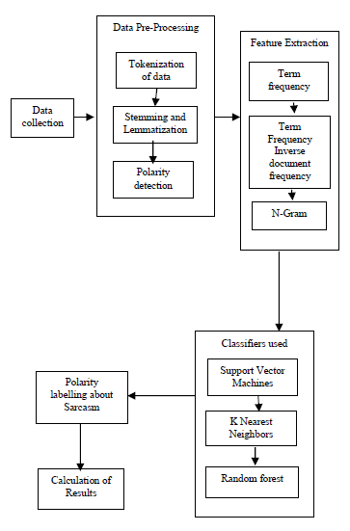
Methodology
Data Collection
Pre-Processing
Feature Extraction
Classification Used
Polarity
Calculation of Results

Slide 5
Methodology
Data Collection: Amazon has got a wide range of datasets. The data is retrieved and converted into sentences. Each review is considered as documents.

Slide 6
Methodology
2. Data Pre-Processing: It’s a preliminary process.
It includes -
a. Tokenization - First step of pre-processing. It helps to tokenize the sentences into words. The words are considered as tokens.
b. Stemming and Lemmatization - The procedure of conversion of words into their root words is Stemming and Lemmatization.
c. Polarity Labelling - The process of labelling the words into positive and negative depending on its polarity is polarity labelling

Slide 7
Methodology
3. Feature Extraction: Next step after pre-processing of data.
It includes -
a. Term Frequency - Every token is considered as a term. Number of times of appearance of a particular term is known as term frequency.
b. TF-IDF - Provides how important a particular word is.
c. N-gram - The presence of sequence of tokens before a particular token or word.
Unigram - Checks for only one prev. word before a particular token
Bi-gram - Checks for only two prev. words before a particular token

Slide 8

Methodology
4. Classifier Used: Categorizing the data on the basis of observation.
SVM - one of the supervised learning algorithms which is used to analyse the data for regression and classification.
K nearest neighbour - uses distance as a function which can be used for pattern recognition and statistical estimation.
Random Forest - A machine learning algorithm. It is used for classification and regression problems.

Slide 9
Conclusions
Sarcastic sentences are very frequently found these days. Determination of these sarcastic sentences is very important. After going through different processes of methodologies in the dataset, sarcastic sentences are found after the classification and these sentences are labelled as sarcastic. Sentiment Words are also been found in this criteria. After the sarcasm detection process, polarity is checked and labelled according to positive or negative.

Slide 10
Limitations
Contextual Understanding : Reviews posted by user might lack context or subtle cues that might make the program difficult to interpret.
Data Imbalance : It can affect the program’s ability to learn sarcasm patterns adequately, leading to biased predictions favoring the majority class (non-sarcastic reviews).

Slide 11
Synthesis
The model can be used in enhancing product development. Like by analyzing sarcastic comments, the model can identify the customers likings and dislikings of the product and the product team can mark the lackings.
The model can be used in cross domain. Not only in Amazon, it can be used in other sources also.
The model can be more useful if we add more data sources like video, images and audio to enhance the interpretation skills for more accurate detection.
The model needs to be optimized for greater efficiency if they are used in real time or large scaled development.

Slide 12
“The End”

